Slide 1
Capstone Project Review - 1
Group - 6
Industry – Tourism & Hospitality
Customer segmentation for personalized Marketing
Team Members:
Javvadi Tilak Sai Prahar
Aakash Murali
Hemanth Srikar Patchalla
Sai Pravallika Pothula

Slide 2

Introduction
Marketing plays a crucial role in every business depending upon the customer needs and satisfaction factor.
To deal with customer preferences, customers must be divided into group based on their unique preferences and their tastes.
By understanding the factors influencing grouped customers, it is the time to focus on personalized marketing.

Slide 3

Problem Statement
A company named “Gogaga Holidays” dealing with the customers across India, has its headquarters in Hyderabad, Telangana. The goal of Gogaga holidays company was to identify the customers with similar tastes and suggest accurate plans according to customer preferences.
Company: Industry:
Tourism and Hospitality

Slide 4

Understanding Problem Statement
Lack of personalized marketing often results in the missed opportunities for customers and increase revenue.
Identifying distinct customer groups can create customized travel packages and marketing strategies which meets specific needs and desires of those segments.
Improving marketing efficiency, enhance customer loyalty and focusing on high revenue from targeted audience.

Slide 5


Industry Trends & Market Demand
Current Industry Trend
Tourism Growth
Online tourism booking is projected to reach Rs. 473Cr by 2023, over 50% of online booking
Global Tourism market was valued at Rs. 1834Cr from 2019 to 2023 which is projected to reach Rs. 2500 Cr seeing a growth.
Market Trend
Customers seek unique and tailored services.
Industry was experiencing steady growth, with annual increase on an average of 4% to 5%

Slide 6
Business Goals and Objectives
What?
Enhance customer engagement with personalized experiences.
Target Customers with suggestion based on preferences
Why?
Maximize returns on marketing investments by advertising tailored offerings.
Target all the customer segments with personalized marketing
Who?

Slide 7
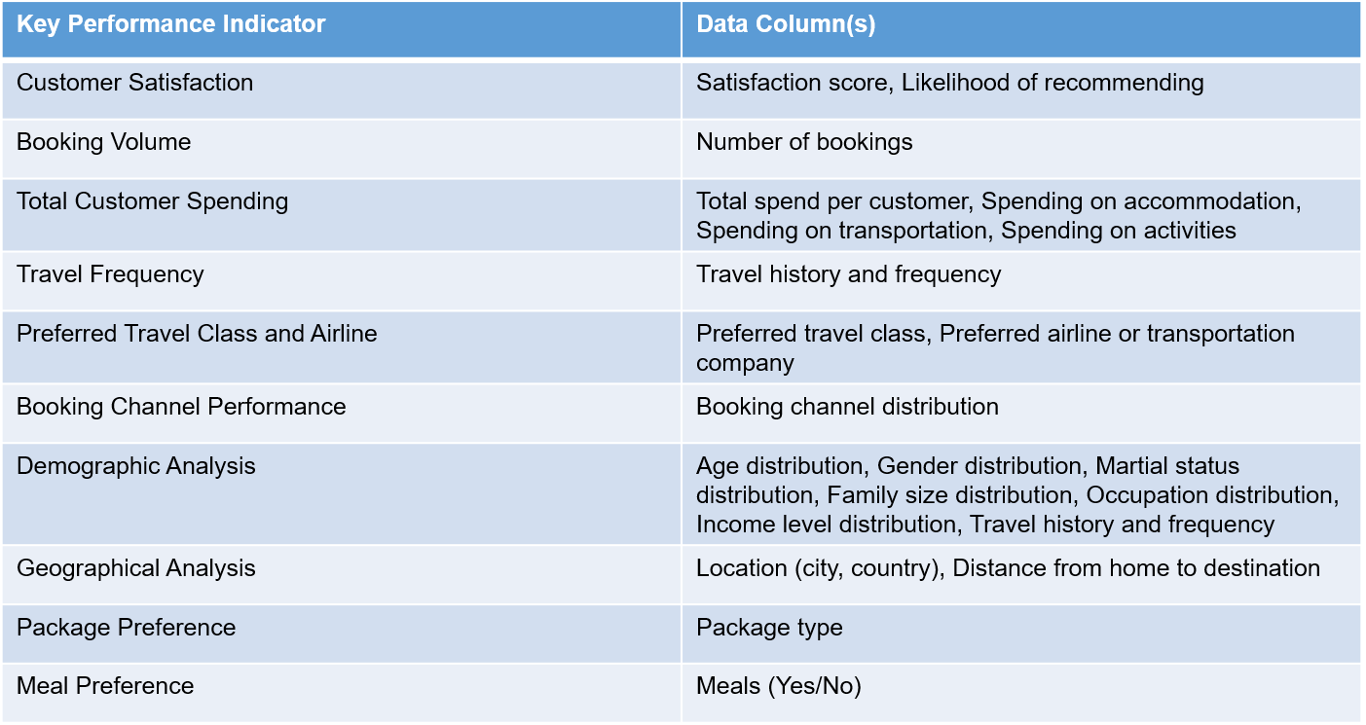
Scope of Data
NO Master Data tables
Transaction Date Table
Customers data
Travel Data
Tourism Data
Hotel Data
Booking ID
Booking Date
Departure Date
Payment Details
KPI:
Increase in customers after personalized marketing
Which category of customers has seen an increase
Average Percentage of new customers after marketing
Measures:
Total Amount spend per customers
Age of Customer
Satisfaction score
Travel distances
Hotel rating
Number of stay
Number of places visited

Slide 8
Scope of Data
NO Master Data tables
Transaction Date Table
Customers data
Travel Data
Tourism Data
Hotel Data
Booking ID
Booking Date
Departure Date
Payment Details
KPI:
Increase in customers after personalized marketing
Which category of customers has seen an increase
Average Percentage of new customers after marketing
Measures:
Total Amount spend per customers
Age of Customer
Satisfaction score
Travel distances
Hotel rating
Number of stay
Number of places visited

Slide 9
Conclusion & Business Benefits
Measurable and Quantifiable Outcomes
1
Customer Frequency
Improved Loyalty
Competitive Advantage
2
Increase in Customer Bookings by clustering them into groups resulting to increase in revenue
More focused and effective use of marketing and customer service resources.
Enhanced ability to predict and respond to customer needs, setting the company apart in the market

Slide 10
Thank You

